Slide 1


Bay Area Rapid Transit Ridership
And the effects COVID-19, the new Silicon Valley expansion, and a station rebuild had on the system.
Presentation By Sean Sirota
Updated to 12/18/2022

Slide 2
Objective
Investigate ridership data for the Bay Area Rapid Transit (BART) system between the years 2020-2021.
Discover what effect the COVID-19 pandemic had on the system’s ridership.
Verify if the opening of two new stations in the system’s southeastern end had any effect on the system’s ridership.
Confirm if the modernization of an existing system had any effect on station ridership and on the system as a whole.

Slide 3
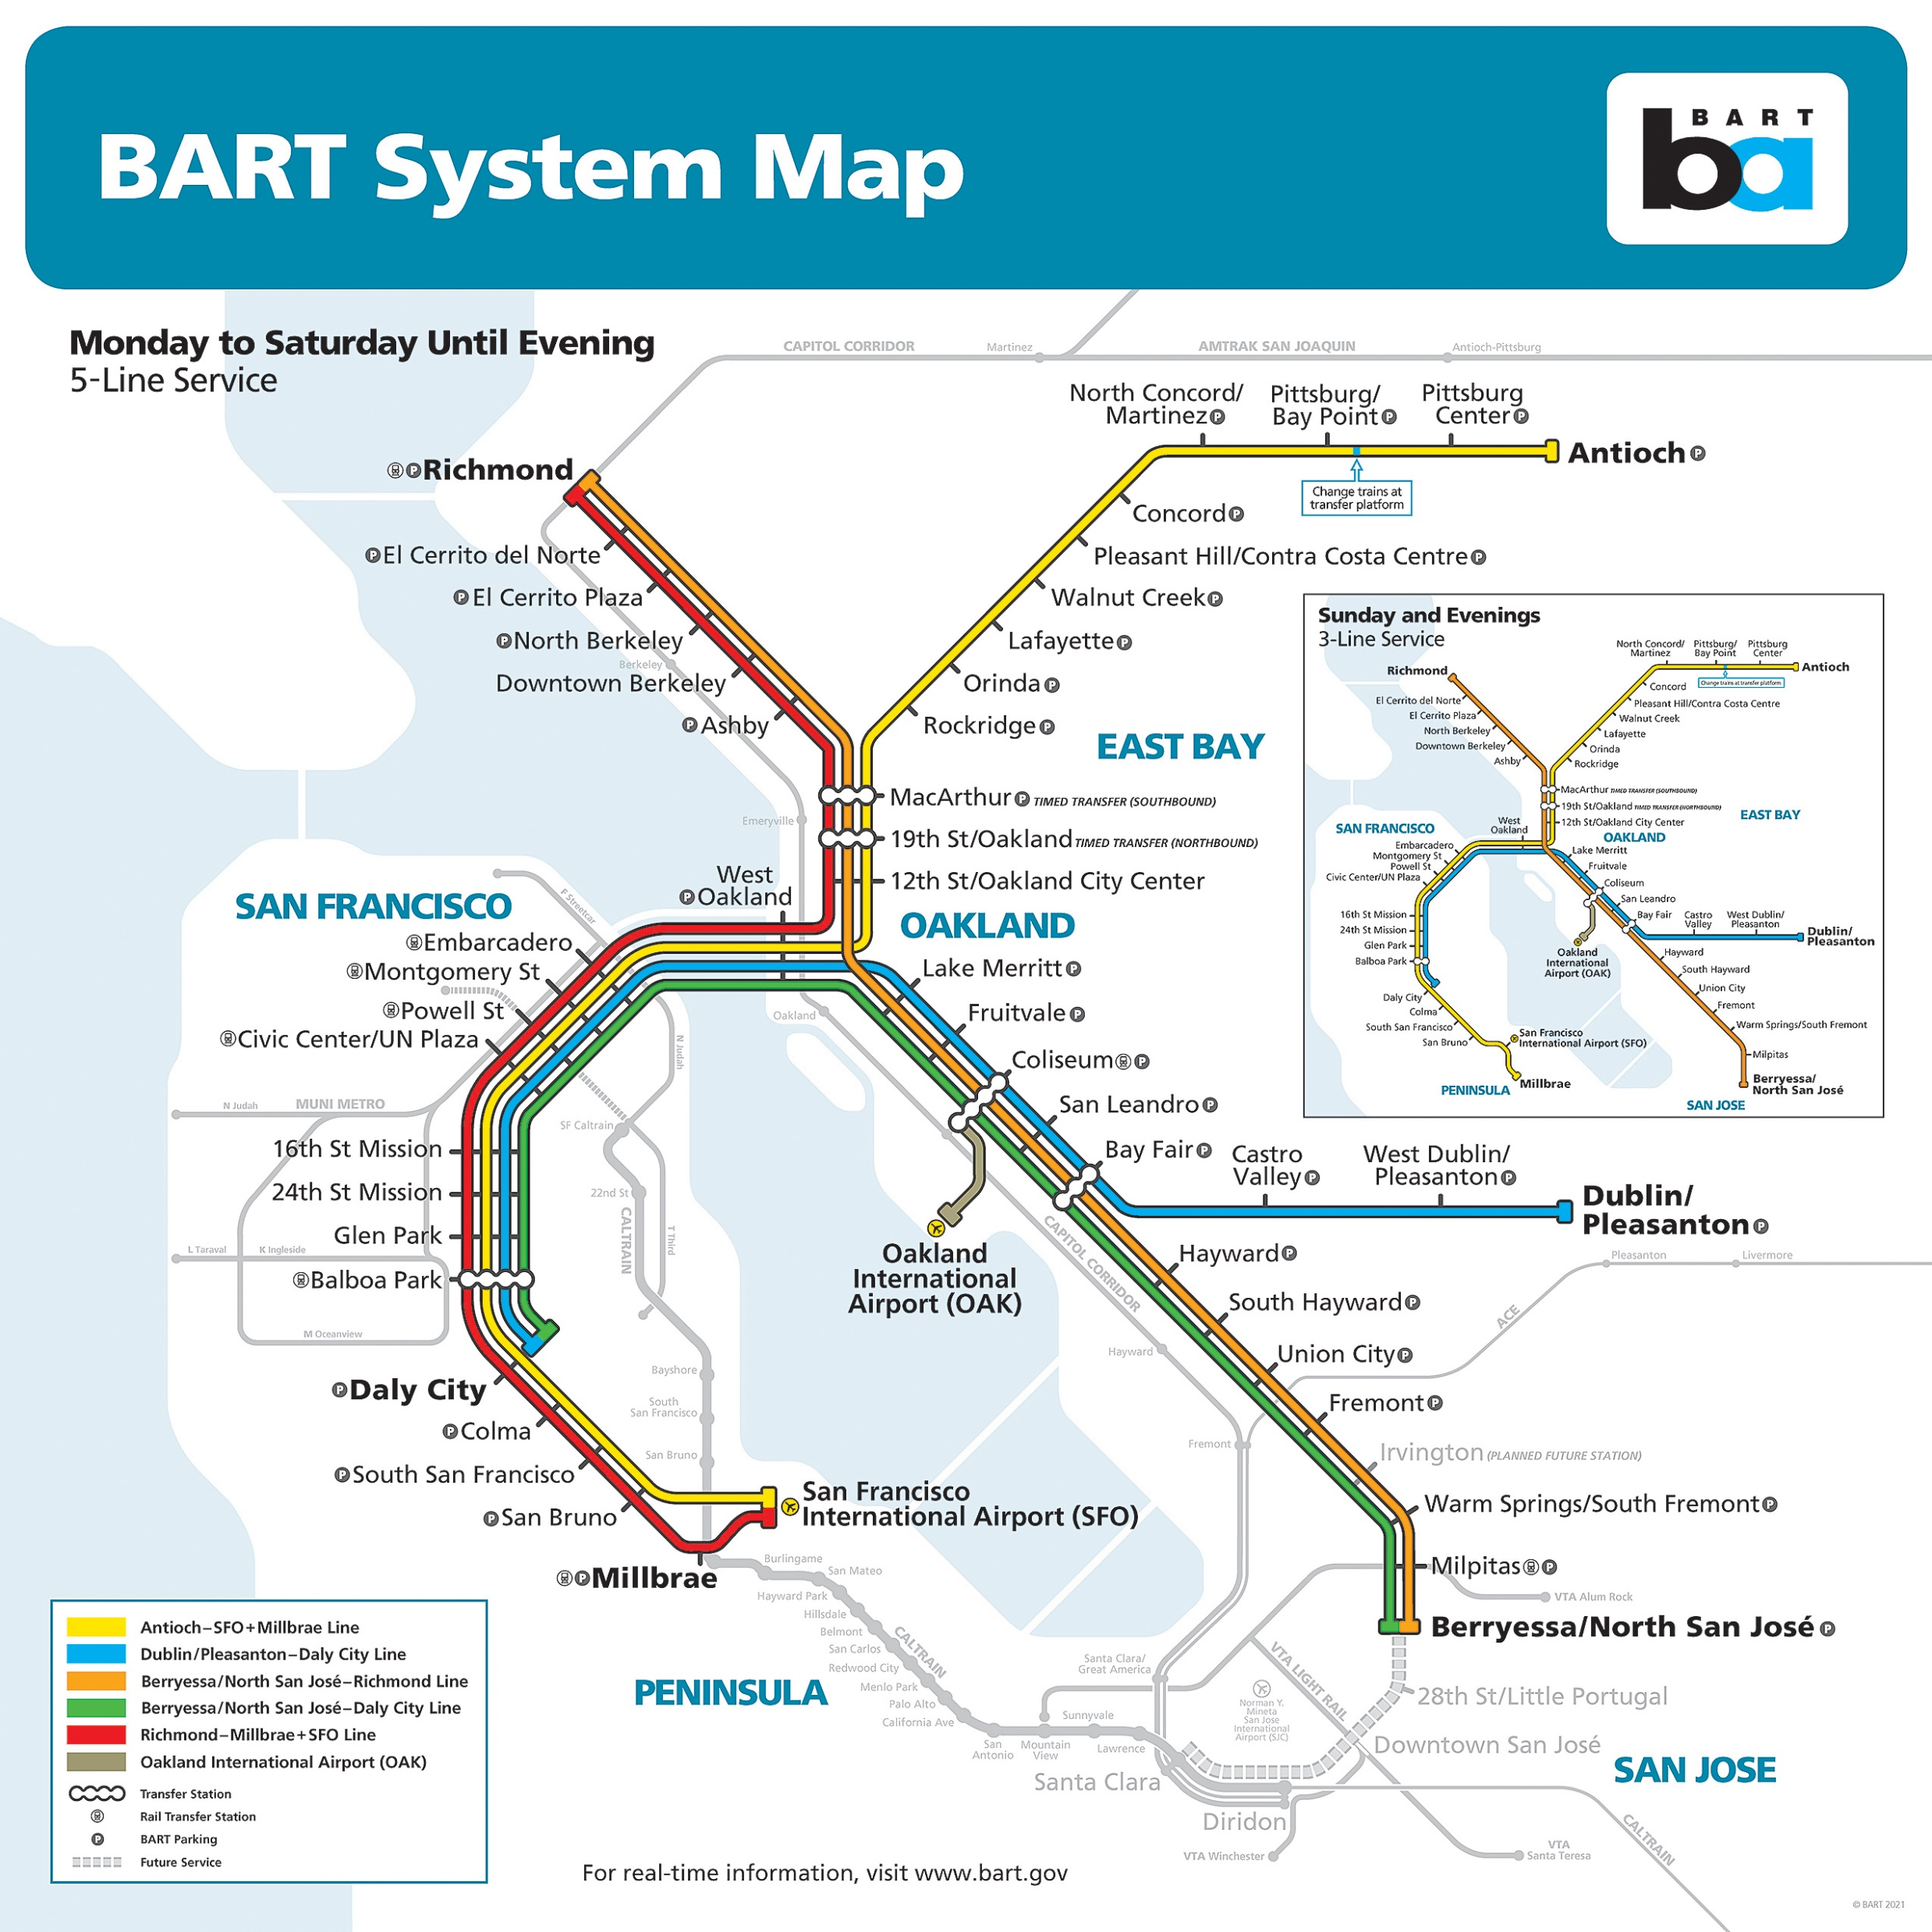
Introduction
Bay Area Rapid Transit (BART) is a rapid transit system consisting of large, high-capacity trains that serve the general Bay Area with frequent service.
It has been operating since September 1972.
BART has served 120.6 million trips in 2019.

Slide 4

Introduction – Cont’d.
The COVID-19 pandemic brought a deadly virus to world that has killed over 6 million people to date.
The Bay Area has also been affected, shutting down businesses region-wide and BART reducing service levels across the system due to decreased ridership.

Slide 5
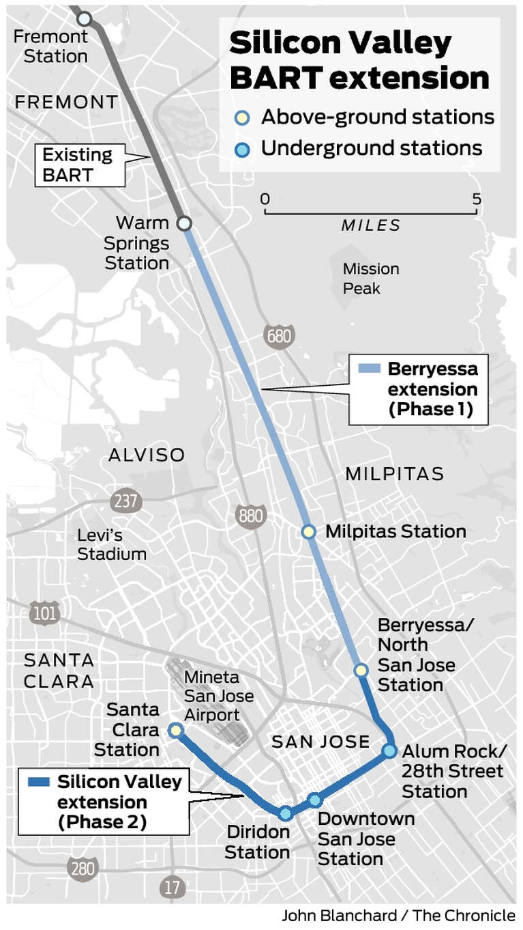
Introduction – Cont’d.
BART opened two new stations as part of its Silicon Valley extension back into June 2020.
Future plans for a phase 2 extension will bring BART further into San Jose with four new stations.

Slide 6
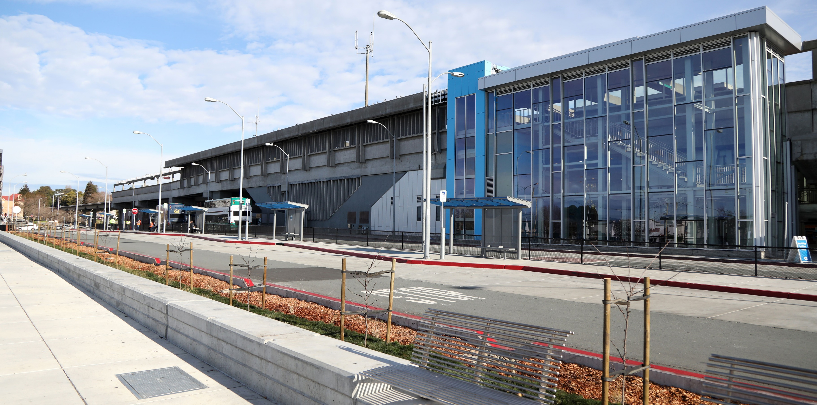
Introduction Cont’d.
In Spring 2021, BART completed a modernization project of the El Cerrito del Norte station. This project included expansion of the station area, new elevators, new stairwells, new restrooms, and more.

Slide 7
Overview of Data
Data used in this case study is publicly available on the BART website by the operating organization.
Data came in the form of a matrix with ridership of people entering stations being the rows and those exiting the same stations being the columns. Each month gets its own ridership matrix spreadsheet.
Exiting station data was excluded from this study to simply the necessary data analysis, and because both entering and exiting ridership was typically the same both aggregate to the same total ridership.
All months between the years 2020-2021 were chosen to study the effects of the pandemic and new stations had on ridership.

Slide 8

COVID-19 Pandemic Effect on BART

Slide 9
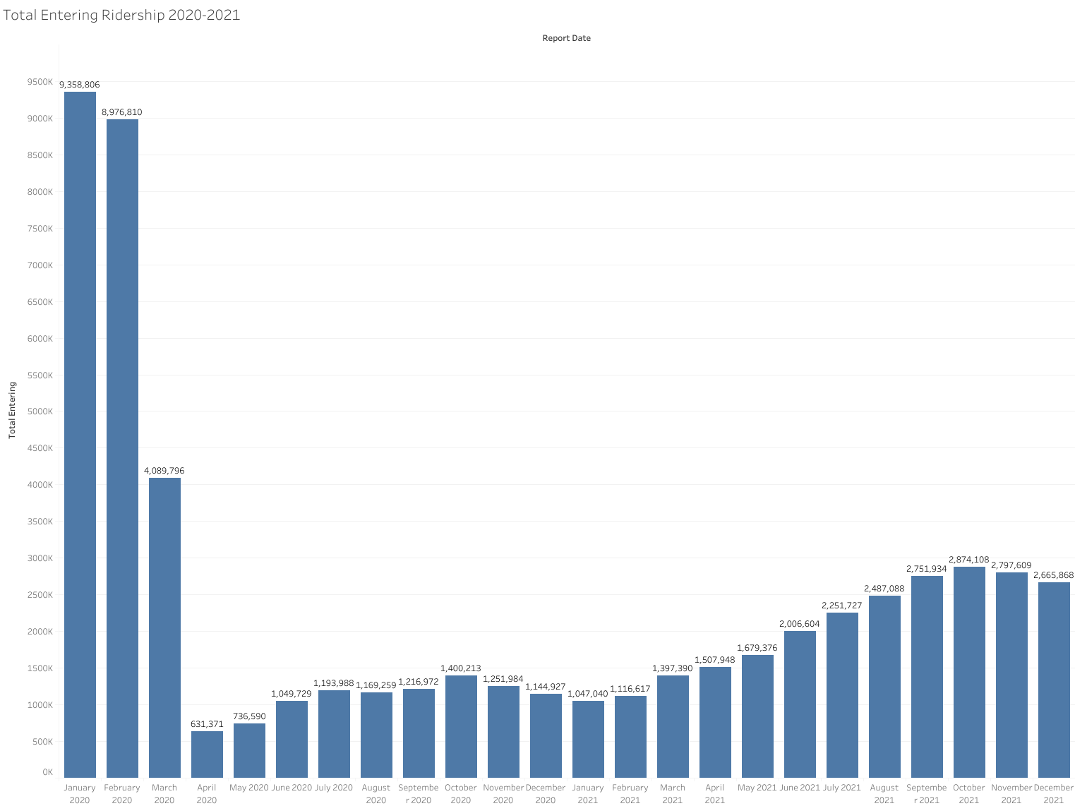
Post-COVID Ridership
Total Ridership 2020-2021
Jan 2020 ridership was 9.4 million people. This was the max for the rest of the time period.
The greatest drawdown was between Jan 2020 and Apr 2020 when COVID first struck the Bay Area at a loss of 1382.3%.
Ridership gradually managed to recover since the first wave of COVID, but has only reached a max ridership of 2.9 million people in Oct 2021; a decrease of 225.6%.
First wave of COVID
Second wave of COVID
Delta variant appears
Third wave of COVID

Slide 10
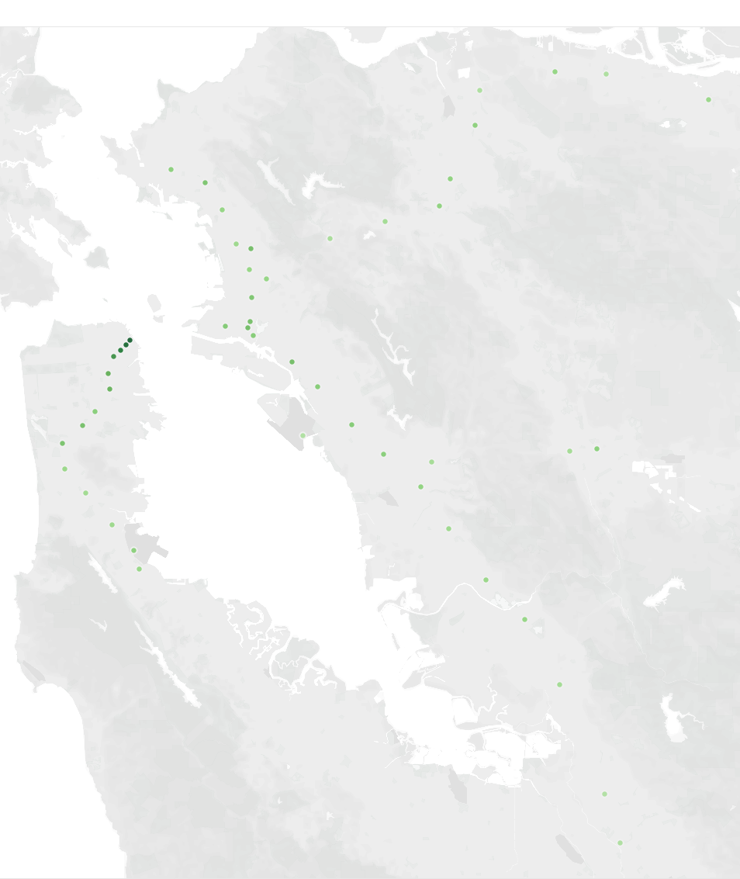
Post COVID Ridership – Cont’d.
Total Ridership 2020-2021 Map
Map shows entering ridership of BART for 2020-2021 aggregated.
Every dot is a station within the system.
Darker green dots have greater people entering the system at that station than lighter green dots.
Stations with highest entering ridership are concentrated in downtown San Francisco along Market Street and Mission Street.
Downtown
San Francisco
Oakland
San Jose/Silicon Valley Expansion

Slide 11
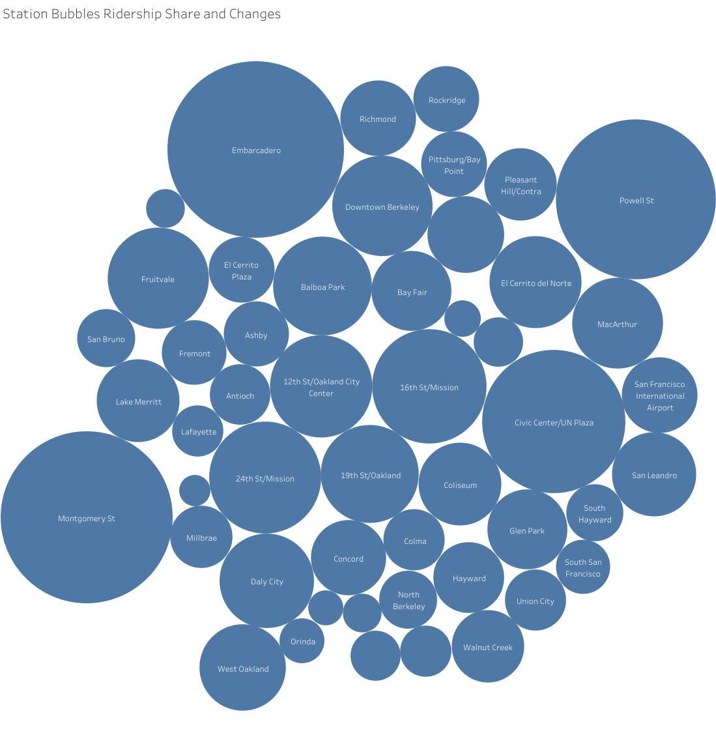
Post COVID Ridership – Cont’d.
Total Ridership 2020-2021 Bubble Chart
Another view of stations with size based on total entering ridership in 2020-2021.
Top six highest ridership stations are all in downtown San Francisco.
Five of the top 15 stations are within Oakland.
Red: Downtown San Francisco
Orange: Oakland

Slide 12
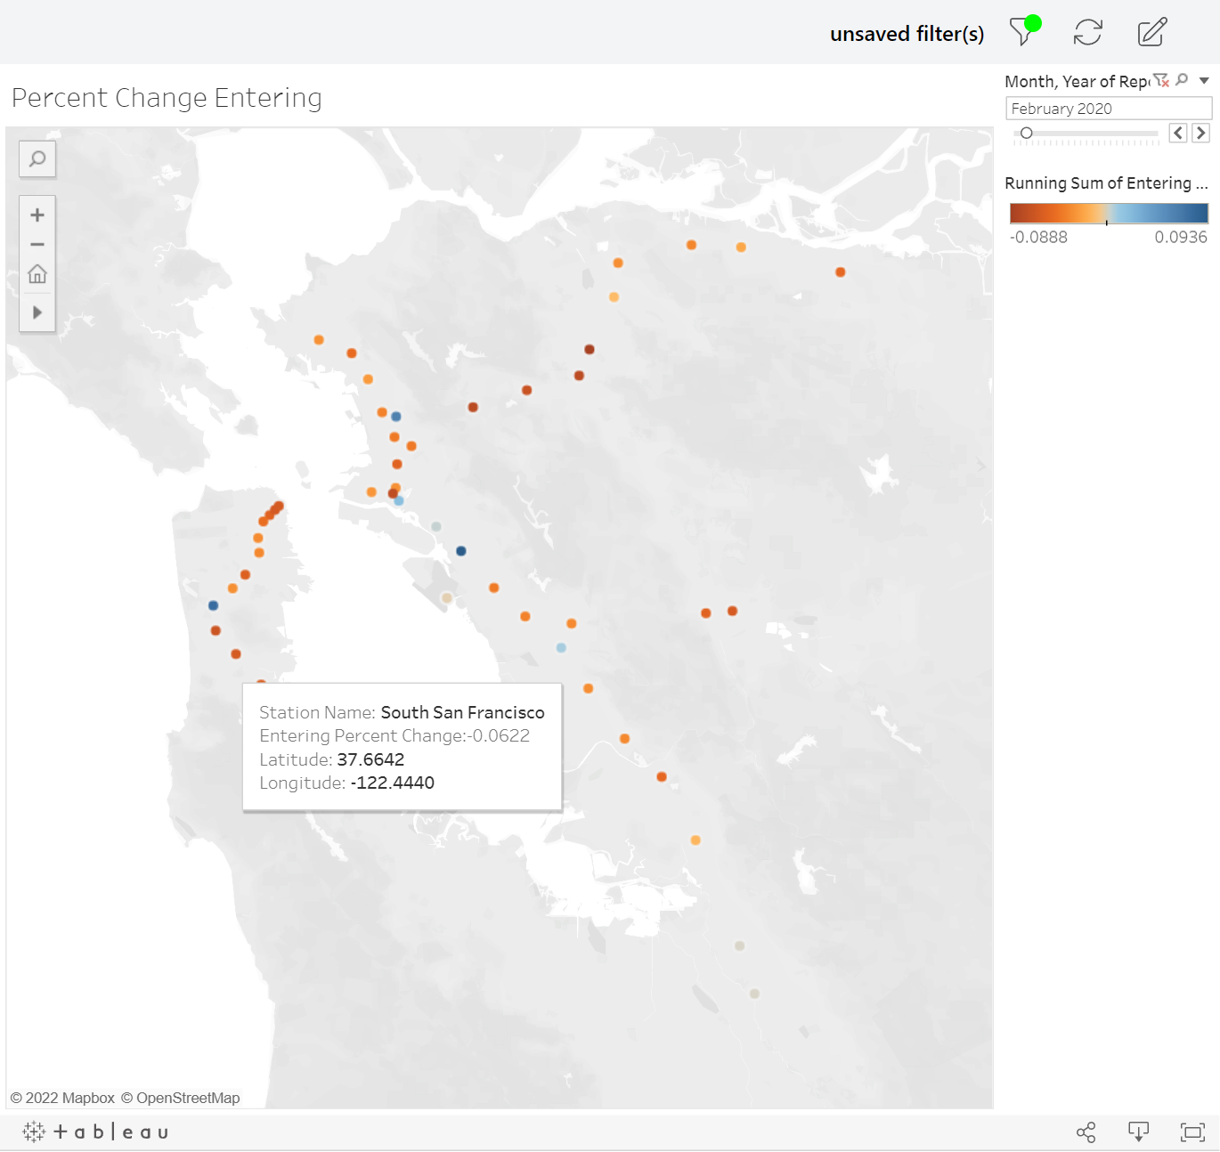
Ridership Changes by Month
Geographic Map of Ridership Changes 2020-2021
This map display ridership changes between months for 2020-2021.
Darker blue dots represent a greater positive change in entering ridership and darker red dots represent a greater negative change.
Periods of decline are as follows:
Jan 2020-Apr 2020: COVID first spreads to Bay Area.
August 2020: Second wave of COVID.
Nov 2020-Jan 2021: Third wave of COVID.
Nov 2021-Dec 2021: Delta variant affects the Bay Area.

Slide 13
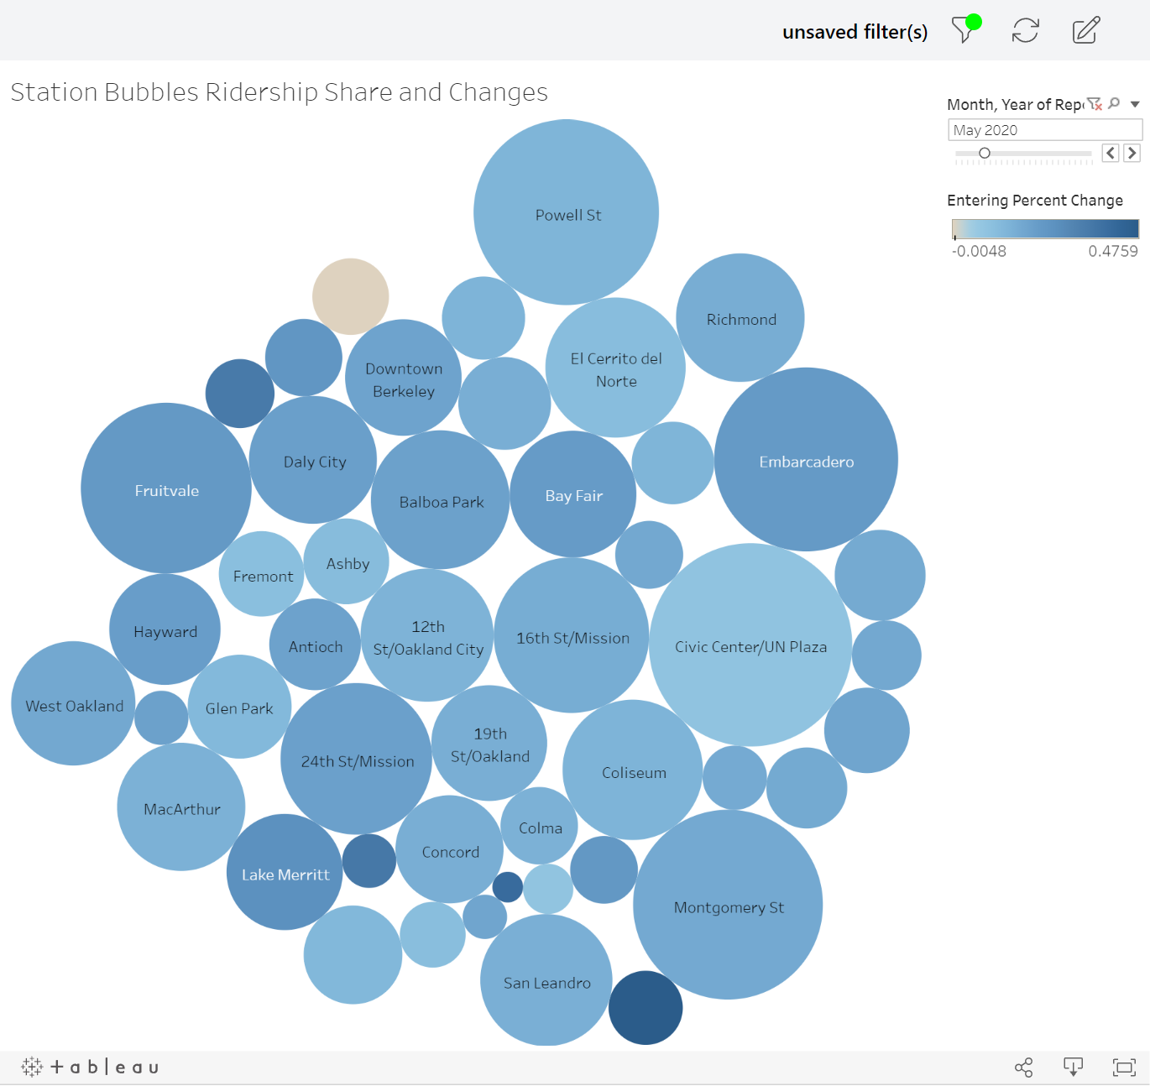
Ridership Changes by Month – Cont’d.
Bubble Map of Ridership Changes 2020-2021
This is a bubble chart also showing ridership changes between months.
Darker blue bubbles represent a greater positive change in entering ridership and darker red bubbles represent a greater negative change.
Larger bubbles have greater ridership. Smaller bubbles have lower ridership.
Effects of COVID can be seen system-wide as all stations turn orange.
Periods of recovery are also visible between waves of COVID when most bubbles turn blue.

Slide 14
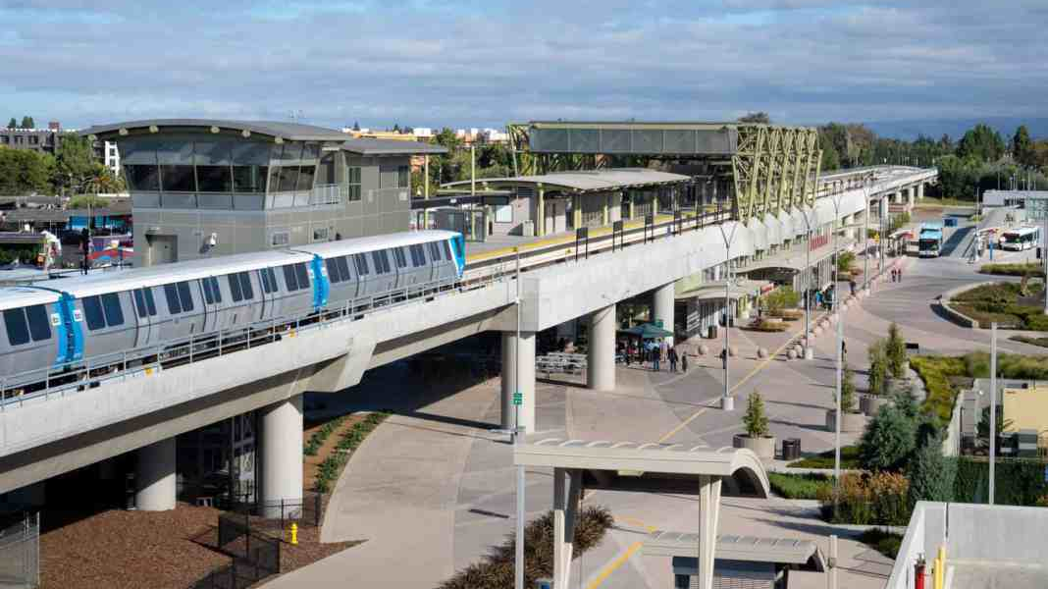
Silicon Valley Expansion Effect on BART

Slide 15
BART Expansion Ridership
Total Ridership 2020-2021
When looking back on the total entering ridership of BART between 2020-2021, no obvious effect can be seen from this chart alone.
The expansion opened in June 2020. Only slight growth can be seen from opening date until August 2020 when the second COVID wave hit and ridership fell again.
This growth may not be correlated to the system expansion and instead to general recovery of ridership after the first COVID wave.
Opening of system expansion
Second wave of COVID

Slide 16
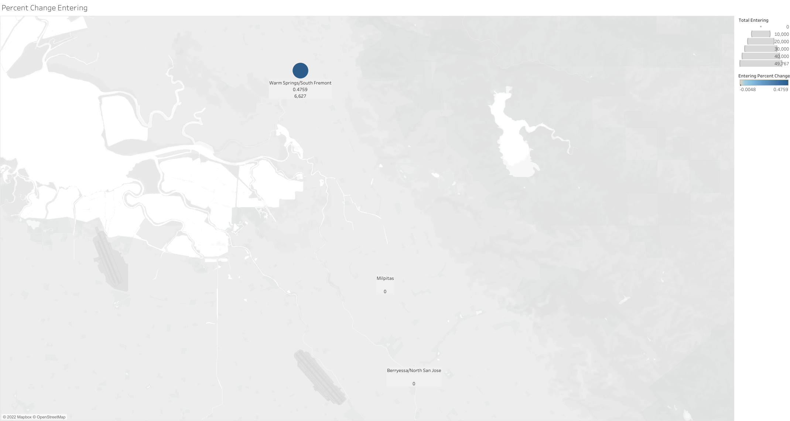
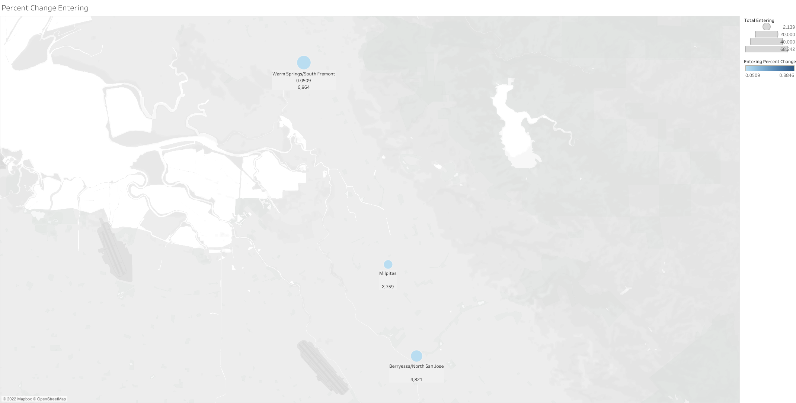
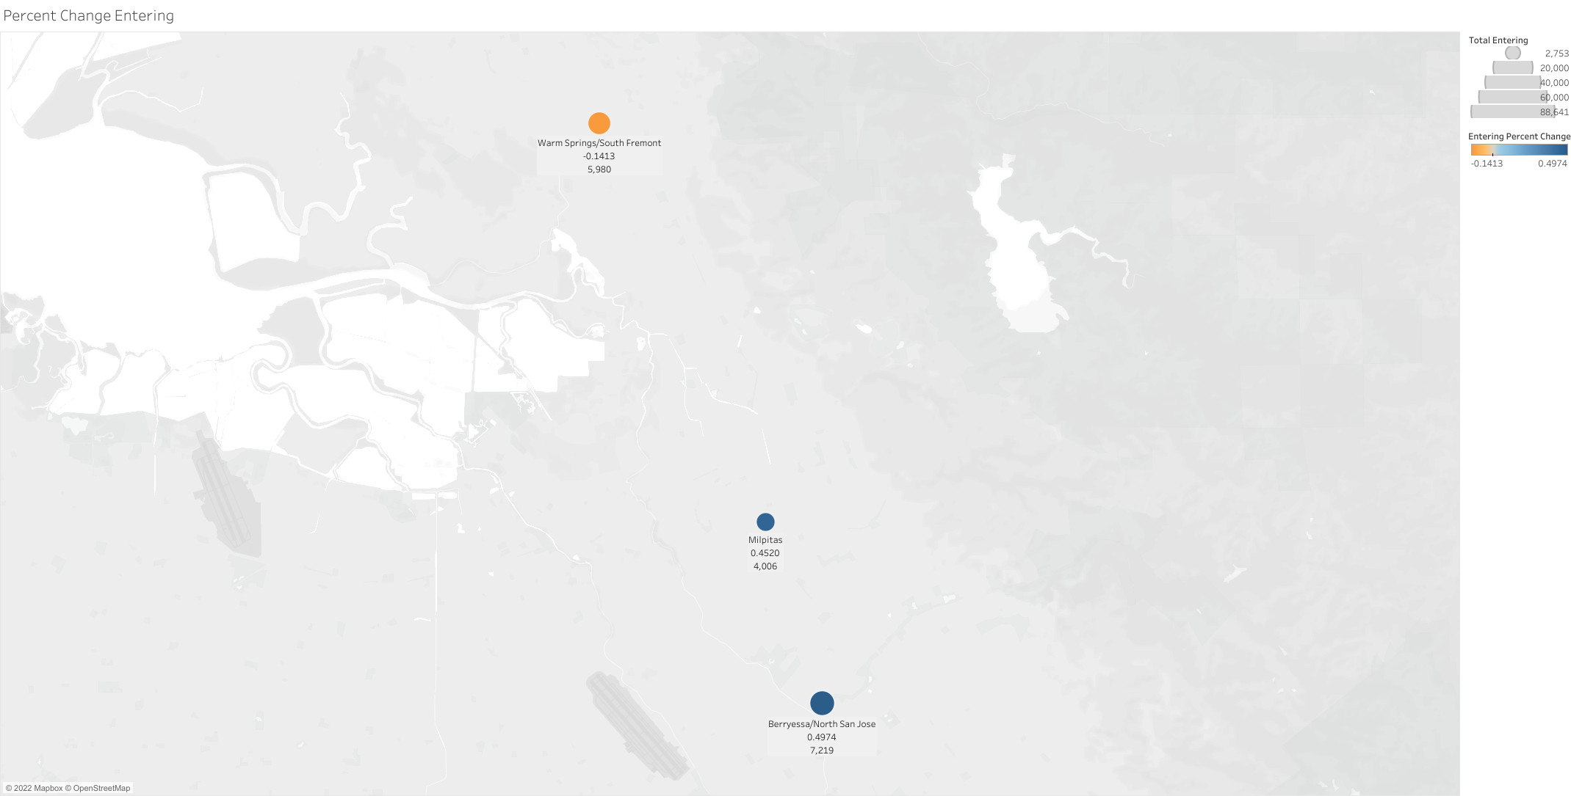
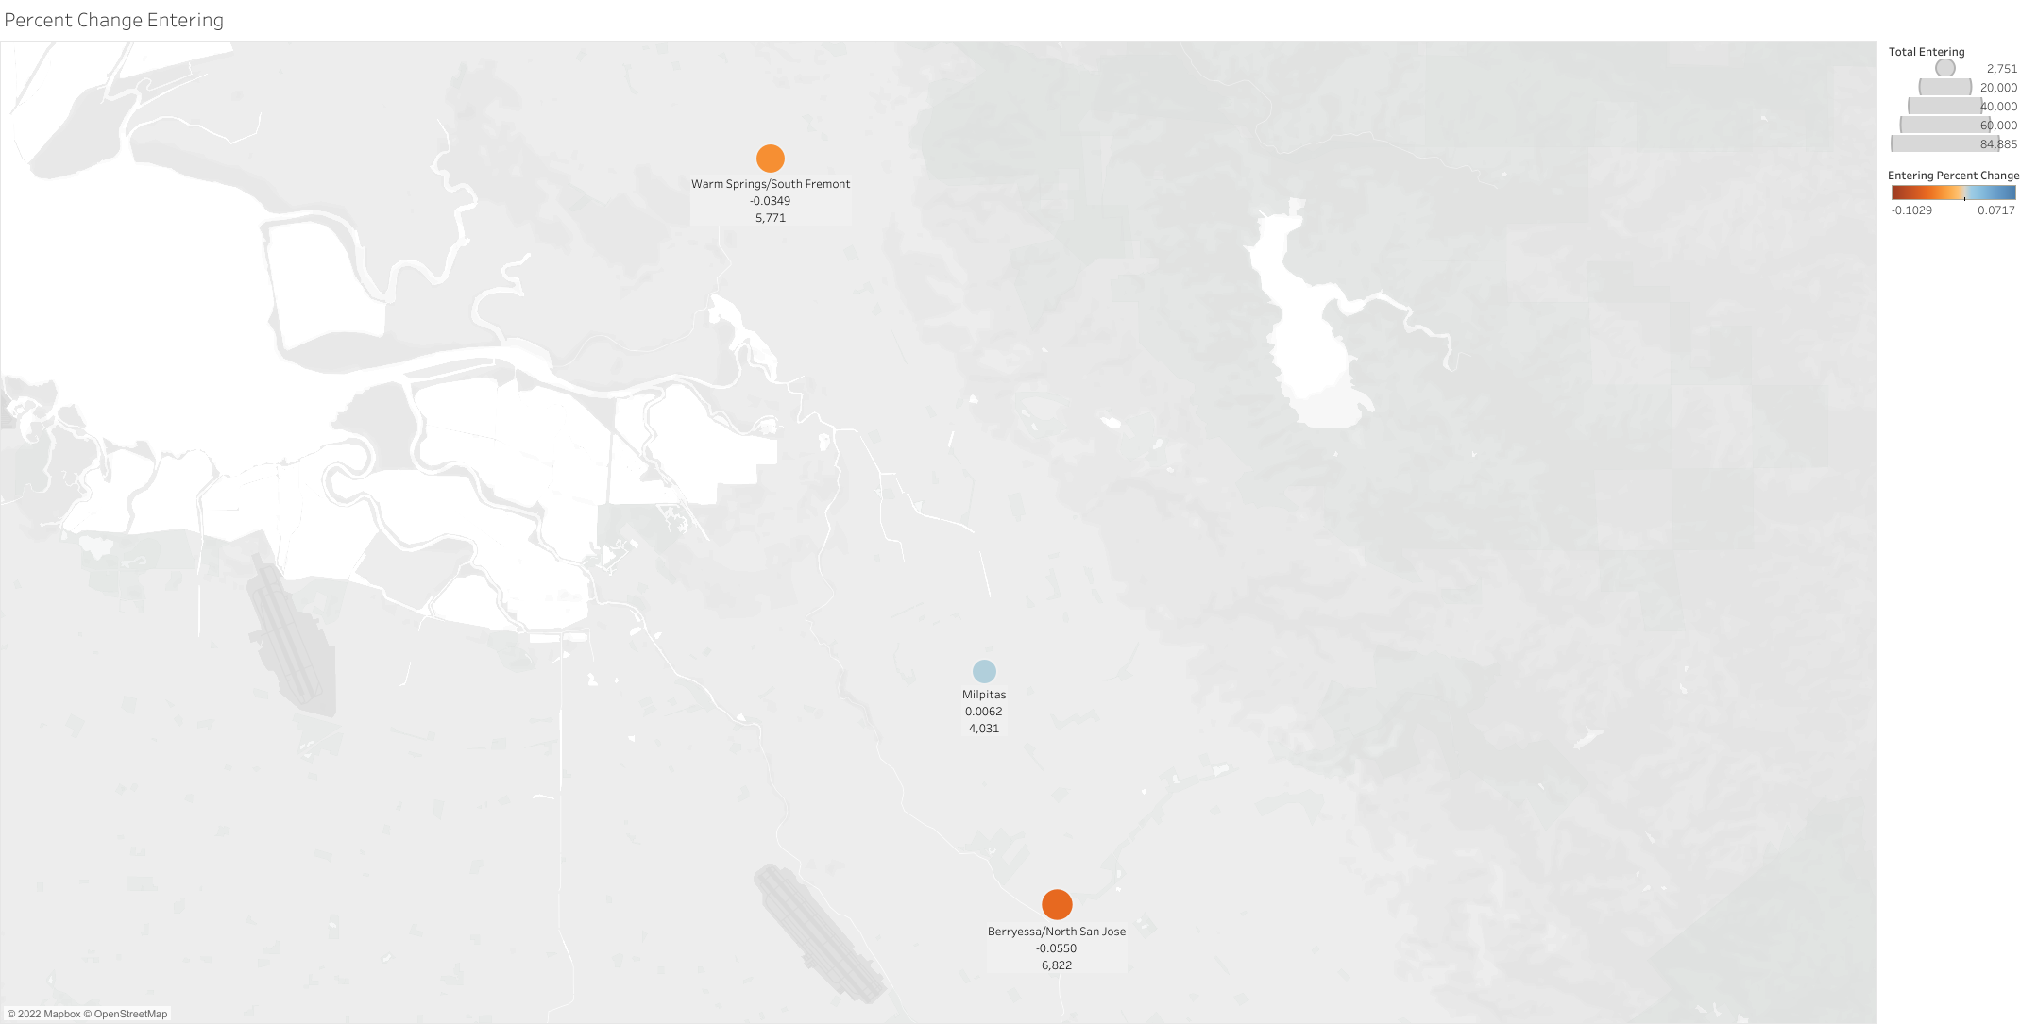
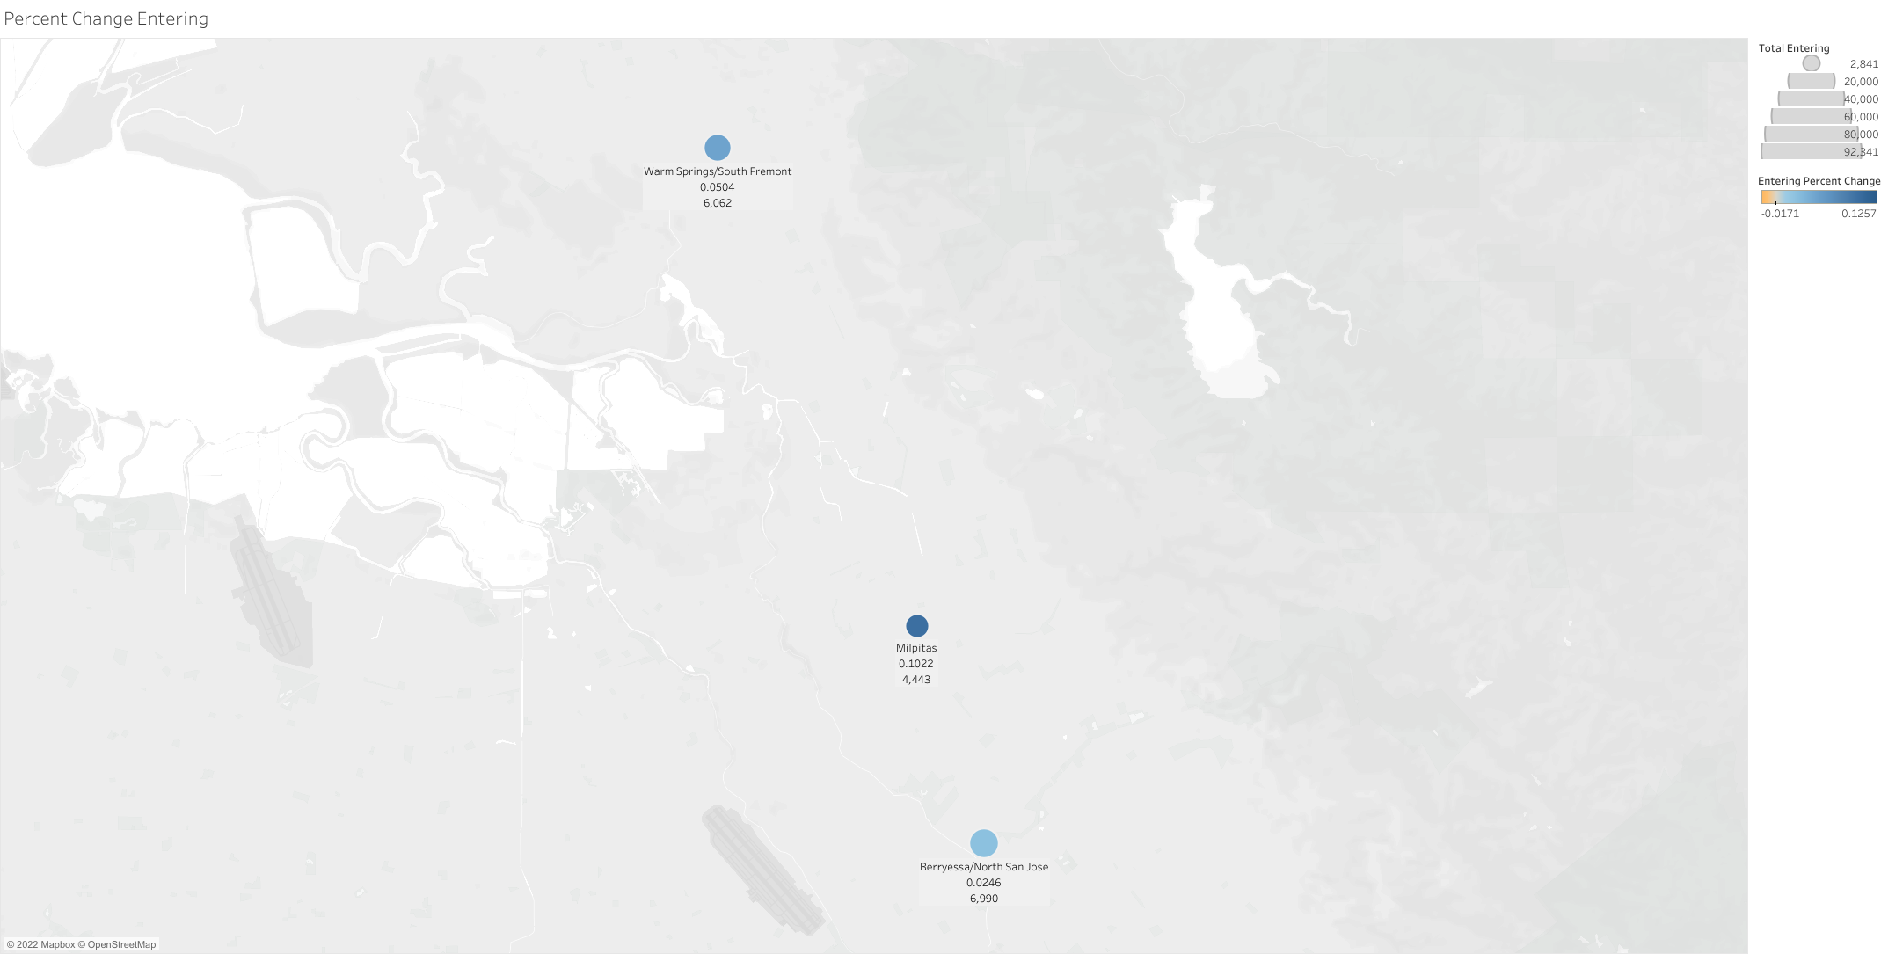
BART Expansion Ridership – Cont’d.
Taking a closer look at the two new stations and the previous terminal preceding them reveals the hidden trend.
Despite ridership recovery between May and July 2020, Warm Springs, the previous terminal, faced a fall in ridership.
At the same time, the two new stations, Milpitas and Berryessa, saw significant increases in ridership after opening.
By September 2020 after the second COVID wave, ridership across all stations stabilized.
May 2020
June 2020
July 2020
August 2020
September 2020

Slide 17
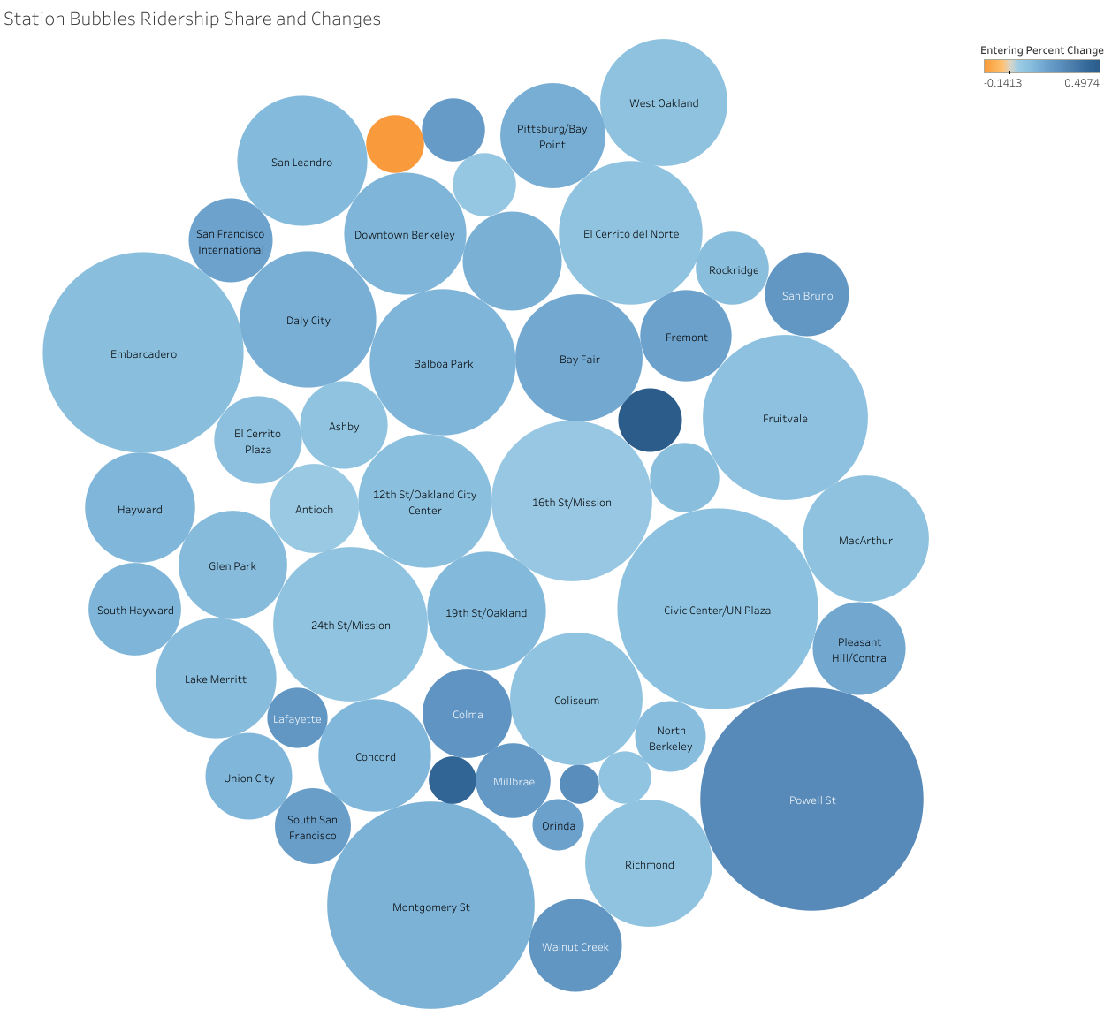
BART Expansion Ridership – Cont’d.
Ridership and Changes – June 2020
This bubble chart for entering ridership and percent change from previous month for June 2020 highlights this trend.
Warm Springs, the previous terminal, is the only station in the whole system during this month to see a decrease in ridership.
Berryessa and Milpitas, the two newest stations, saw the largest increases in ridership, being the darkest blue.
Red: Warm Springs Station
Orange: Berryessa/North San Jose Station
Purple: Milpitas Station

Slide 18
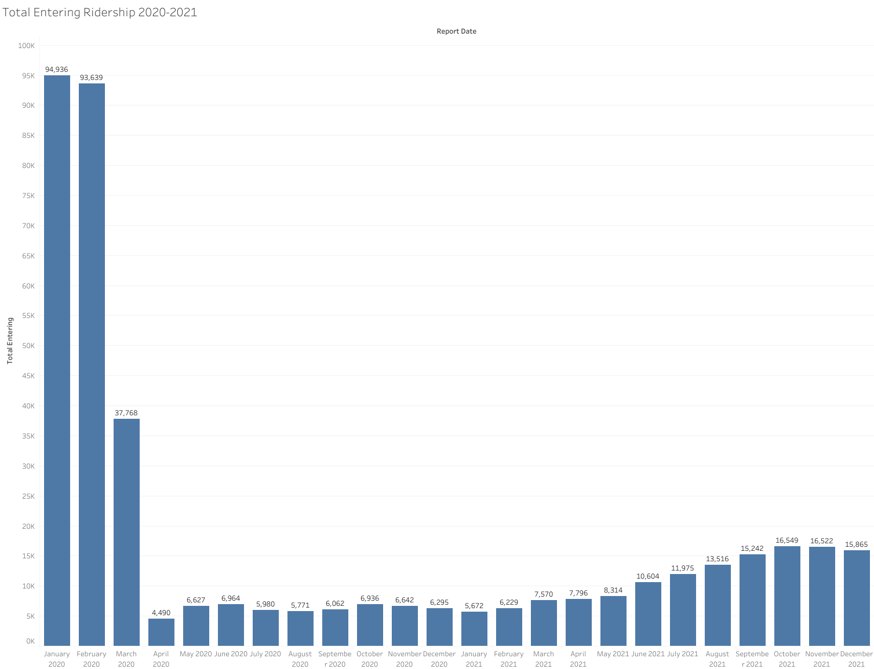
BART Expansion Ridership – Cont’d.
Warm Springs – Total Ridership 2020-2021
When taking a closer look at the entering ridership of Warm Springs in 2020-2021, the anomaly can be found.
Despite the rest of the system recovering ridership in the May 2020-July 2020, Warm Springs has a noticeable decrease in ridership right after the opening of the new stations.
This drop in ridership is right in the middle of this recovery period.
Dip in ridership during recovery period
Second wave of COVID

Slide 19
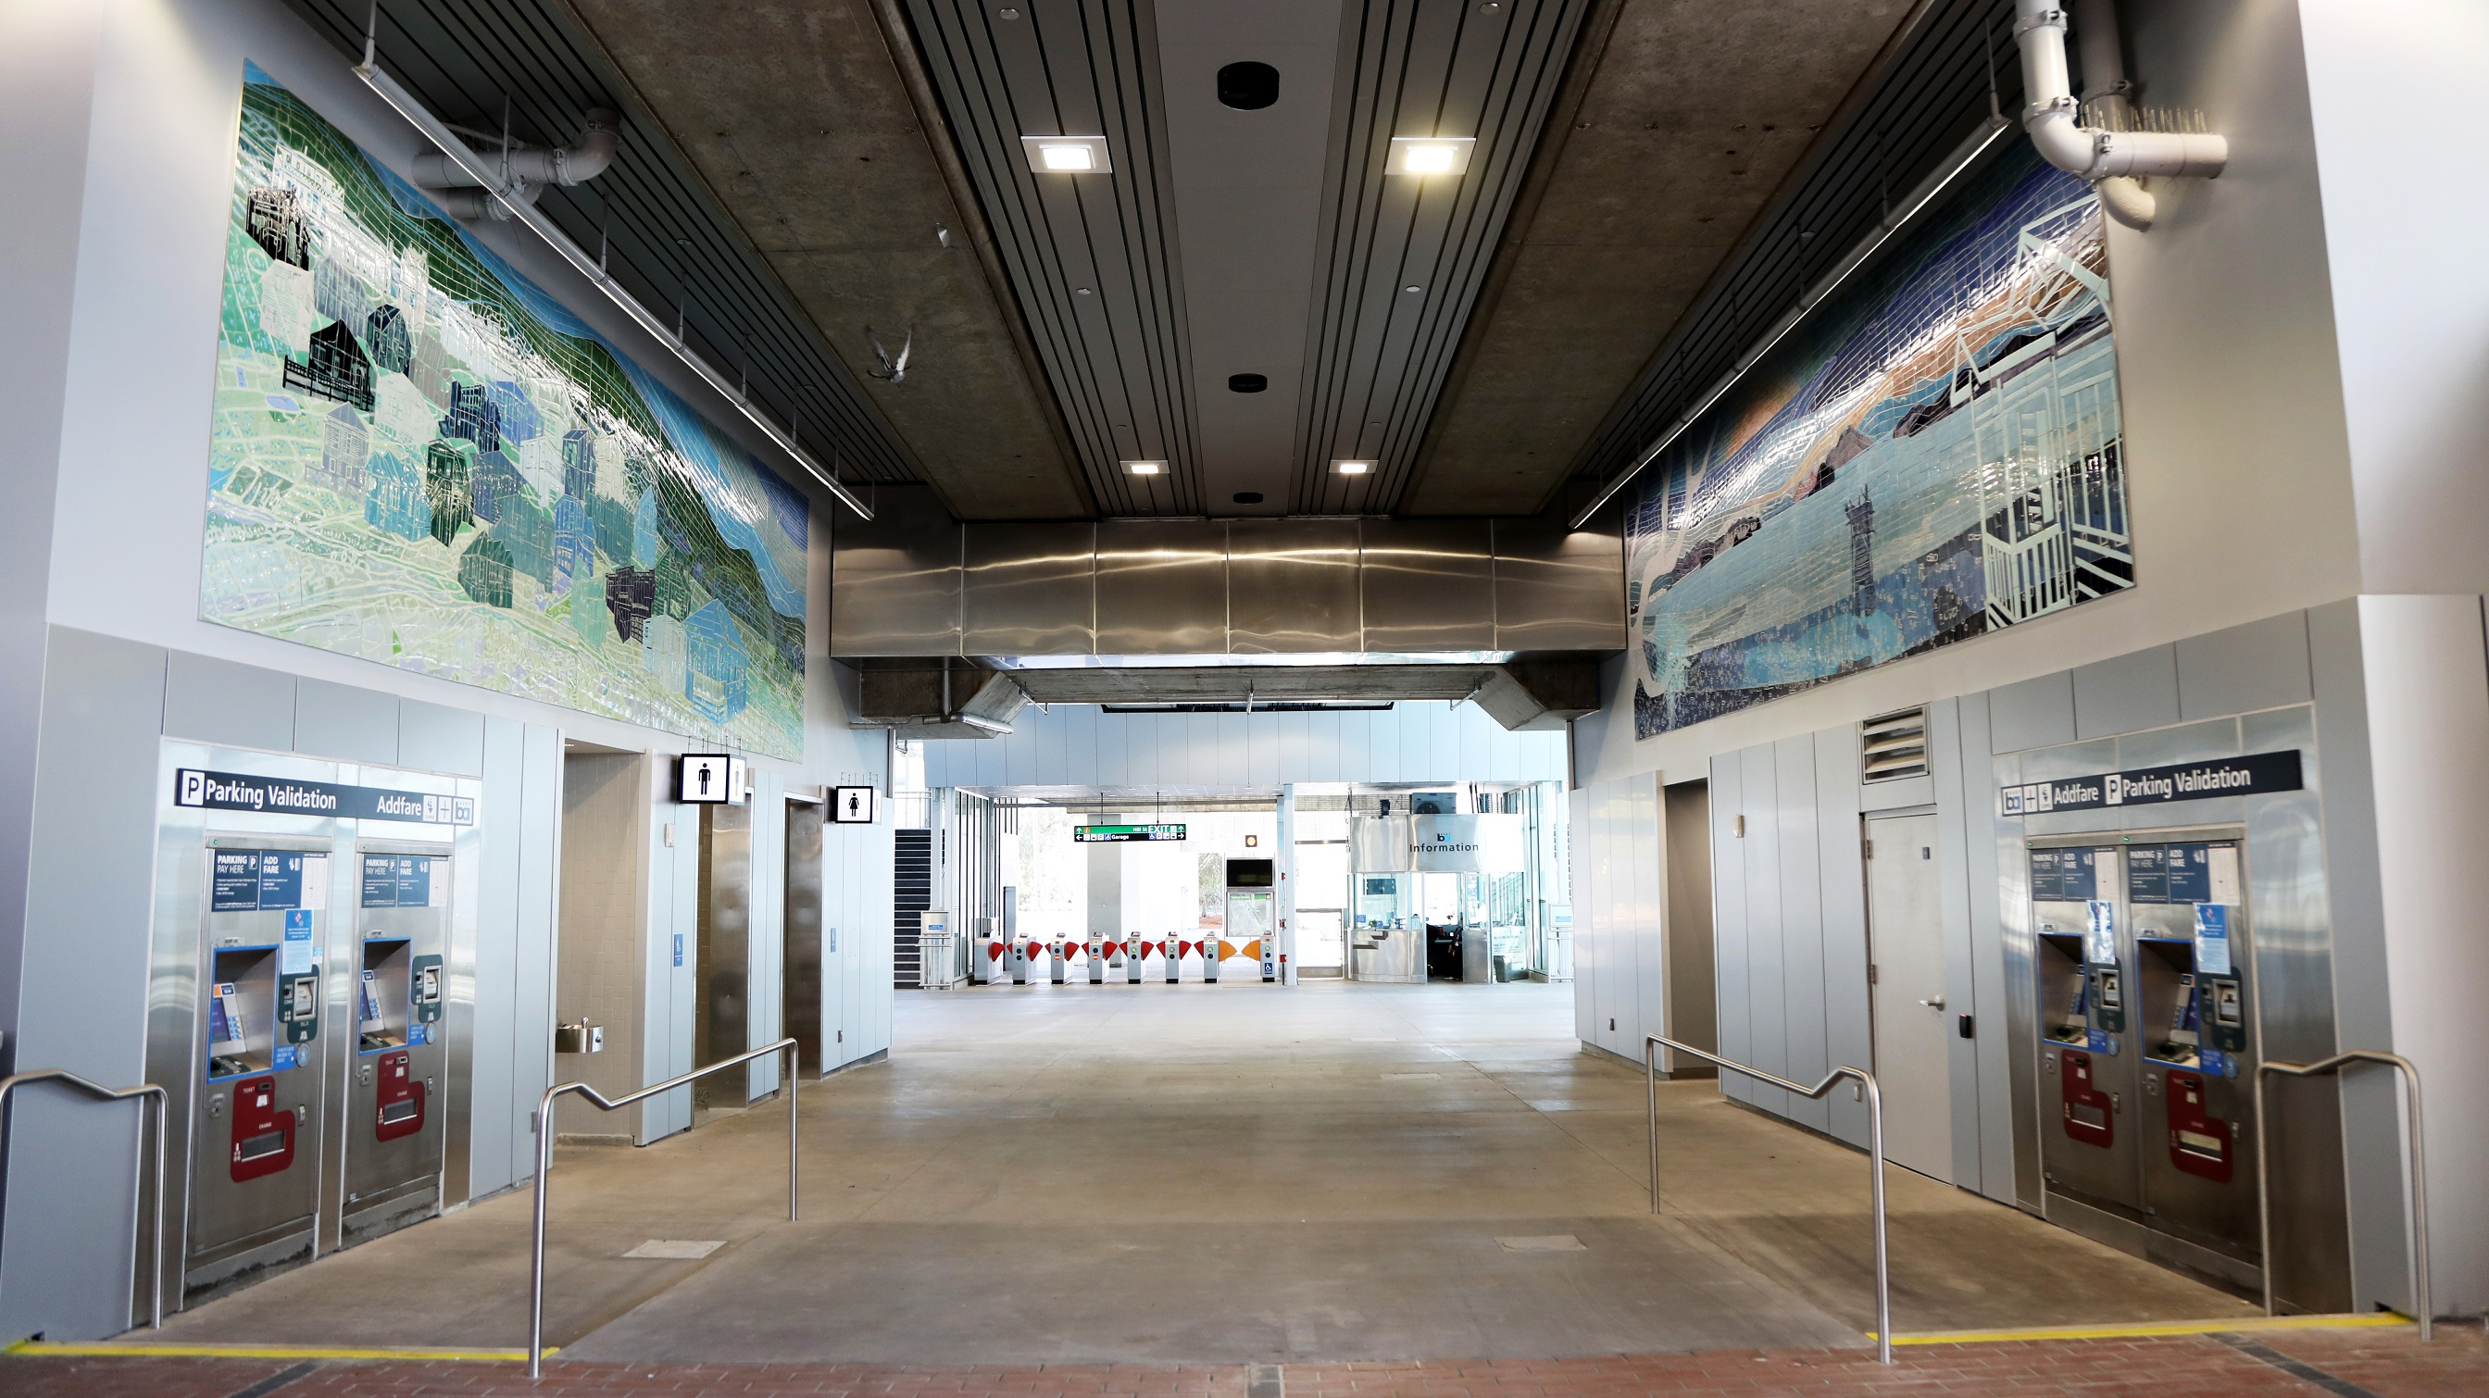
Station Modernization Effect on BART

Slide 20
El Cerrito del Norte Modernization
BART began the modernization of the El Cerrito del Norte station in 2017.
Project was completed in two phases in Feb 2021 and Mar 2021.
Modernization of the station was undertaken mainly to increase capacity for riders.
Purple: El Cerrito del Norte Station

Slide 21




Station Reconstruction Ridership Effect
Between Jan 2020 and Feb 2021, El Cerrito del Norte experienced no significant difference in ridership from other stations while undergoing modernization.
Starting in Mar 2021 until Apr 2021, the station saw a significant drop in ridership. It went from 35,657 riders in Feb 2021 to 15,716 riders in Apr 2021; that is a decrease of 127%.
After construction was completed in Mar 2021, ridership didn’t rebound until May 2021, which saw 45,726 riders; an increase of 191%.
Feb 2021
Mar 2021
Apr 2021
May 2021
Red: El Cerrito del Norte Station

Slide 22
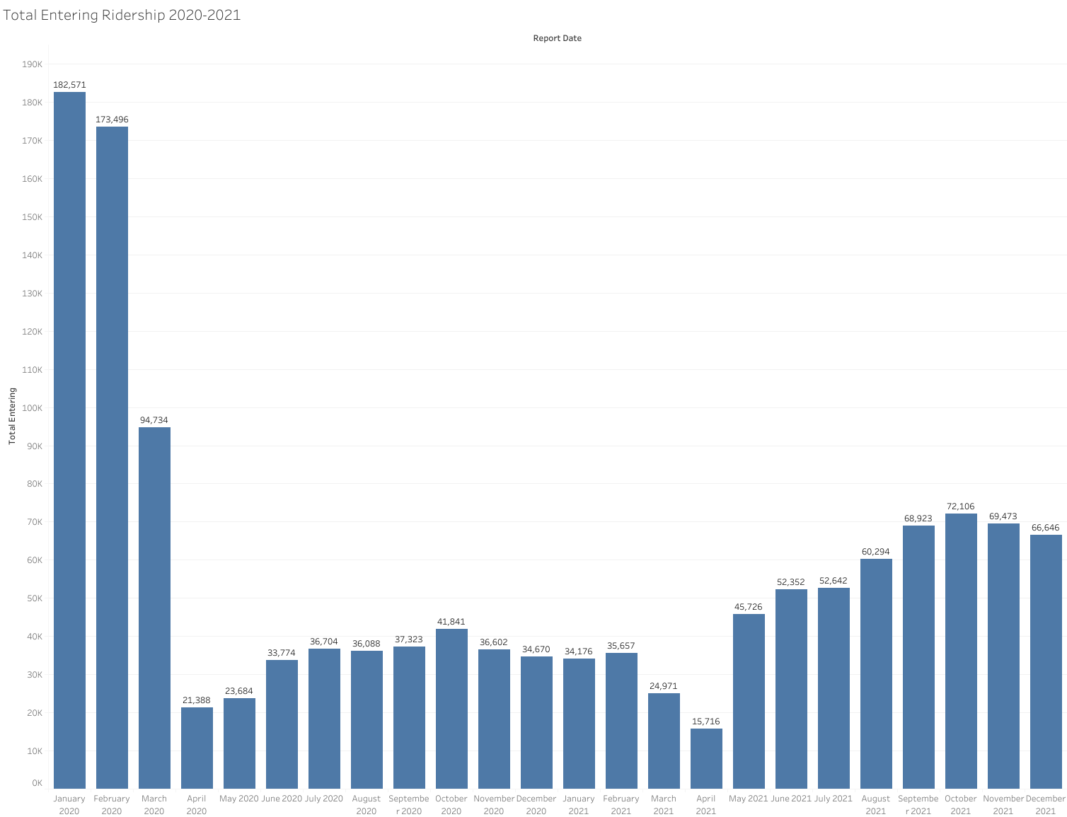
Station Reconstruction Ridership Effect
El Cerrito del Norte – Total Ridership 2020-2021
Here is a chart showing the entering ridership over time for the El Cerrito del Norte station from 2020-2021.
Note the significant dip in ridership in Mar 2021 and Apr 2021.
It is unclear if the modernization project had a significant positive impact on the station ridership.
The large decrease in ridership during the end of the project is likely due to heavy construction impacting operations.
End of modernization

Slide 23
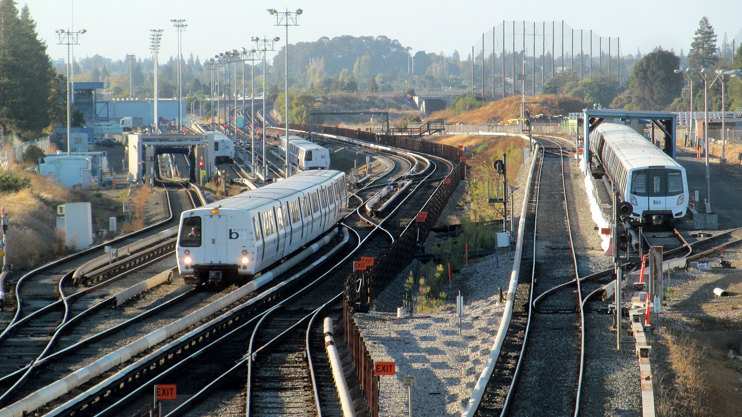
Conclusion

Slide 24
Takeaways
The COVID-19 pandemic had a significant impact on BART ridership. Each new wave of COVID-19 caused the system to decrease in ridership for several months at a time.
Ridership gradually recovers in between COVID-19 waves system-wide.
Silicon Valley Expansion had no significant effect on ridership of the entire BART system. However, it did steal ridership from the nearby Warm Springs station for a brief period after opening of the new stations.
The new stations proved to be successful. They rapidly grew in ridership after opening even as Warm Springs recovered its stolen ridership back.
The El Cerrito del Norte modernization project had no significant effect on ridership of the entire BART system. However, heavy construction near the end of the project caused disruptions in ridership.

Slide 25
Further Investigation Needed
Analysis of more recent data may prove useful to discover how well BART recovered from the COVID-19 pandemic.
Find out why Coliseum station grew by 44% in August 2021 and then fell again by 40%. Brief investigation reveals a connection to the sports arenas near the station and events that took place in that time period.
Find out why Downtown Berkeley had significant growth of 82% between July 2021 and September 2021.

Slide 26

Thank you!

